Slide 1
INVOICE MATCHING WITH PURCHASE ORDER
R.HARINI
1813323037012

Slide 2
AIM
The aim of this project to extract details from different invoices and to compare with bills.
OBJECTIVES
Processing time is reduced by 80%.
Enable fully touchless invoice processing.
Reduces human error.

Slide 3
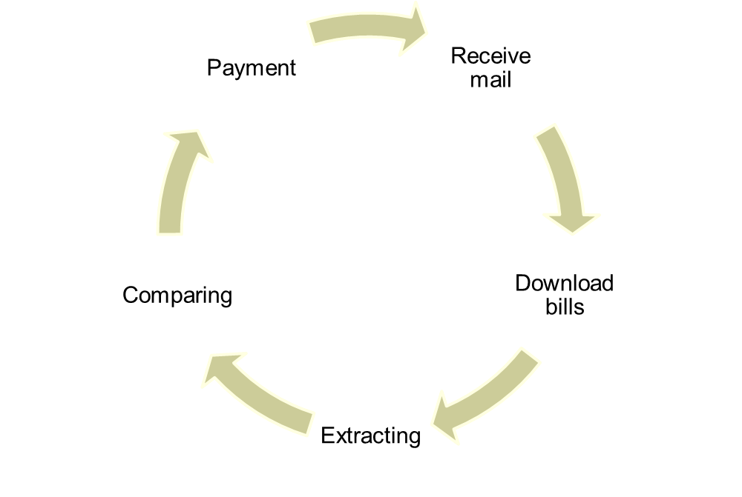
PROCESS FLOW

Slide 4
ROBOTIC PROCESS AUTOMATION(RPA)
Robotic process automation (RPA) is a software technology that makes it easy to build, deploy, and manage software robots that emulate humans actions interacting with digital systems and software.

Slide 5
UI PATH
UiPath is a Robotic Process Automation tool that is used for Windows desktop automation.
It is used to automate repetitive/redundant tasks and eliminates human intervention.
The tool is simple to use and has a drag and drop functionality of activities.

Slide 6
AKAUNTING APPLICATION
Akaunting is a free and online accounting software designed for small businesses to manage their finances.
Invoicing, accepting online payments and keeping track of expenses.
Akaunting is built with modern technologies such as Laravel, VueJS, Bootstrap 4, RESTful API etc.

Slide 7
MODULES
Initialization-Download the attachment from invoice mail
Get transaction data-Pass the path of the downloaded attachment
Process-Extract the invoice details and compare with bills
End process-Close the application

Slide 8
CONCLUSION
Automated invoice processing can achieve powerful results for accounts payable departments.
Automated invoice processing enables touchless automation across the entire accounts payable process, and can transform the business in just months, creating a powerful return on investment.

Slide 9
Any Questions?
Thank You

